Slide 1
Conversion between various number systems
Number systems: binary, decimal, hexadecimal and octal

Slide 2
Decimal numbers
In the decimal number systems each of the ten digits, 0 through 9, represents a certain quantity. The position of each digit in a decimal number indicates the magnitude of the quantity represented and can be assigned a weight. The weights for whole numbers are positive powers of ten that increases from right to left, beginning with 10º = 1
……………10 10 10³ 10² 10¹ 10º
For fractional numbers, the weights are negative powers of ten that decrease from left to right beginning with 10¯¹.
10² 10¹ 10º . 10¯¹ 10¯² 10¯³ ……..
The value of a decimal number is the sum of digits after each digit has been multiplied by its weights as in following examples.

Slide 3
1.Express the decimal number 87 as a sum of the values of each digit.
Solution: the digit 8 has a weight of 10, which is 10, as indicated by its position. The digit 7 has a weight of 1, which is 10º, as indicated by its position.
87 = (8 x 10) + (7 x 10º) = (8 x 10) +
(7 x 1) = 87
Determine the value of each digit in 939
2.Express the decimal number 725.45 as a sum of the values of each digit.
725.45 = (7 x 10²) + (2 x 10¹) + (5 x 10º) + (4 x 10¯¹) +
(5 x 10¯²) = 700 + 20 + 5 + 0.4 + 0.05

Slide 4
BINARY NUMBERS
The binary system is less complicated than the decimal system because it has only two digits, it is a base-two system. The two binary digits (bits) are 1 and 0. The position of a 1 or 0 in a binary number indicates its weight, or value within the number, just as the position of a decimal digit determines the value of that digit. The weights in a binary number are based on power of two as:
….. 2 2³ 2 2 2º . 2¯ 2¯……….
With 4 digits position we can count from zero to 15. In general, with n bits we can count up to a number equal to 2ⁿ - 1.
Largest decimal number = 2ⁿ - 1

Slide 5
A binary number is a weighted number.
The right-most bit is the least significant bit (LSB) in a binary whole number and has a weight of 2º =1.
The weights increase from right to left by a power of two for each bit.
The left-most bit is the most significant bit (MSB); its weight depends on the size of the binary number.

Slide 6
Decimal number Binary number
0 0 0 0 0
1 0 0 0 1
2 0 0 1 0
3 0 0 1 1
4 0 1 0 0
5 0 1 0 1
6 0 1 1 0
7 0 1 1 1
8 1 0 0 0
9 1 0 0 1
10 1 0 1 0
11 1 0 1 1
12 1 1 0 0
13 1 1 0 1
14 1 1 1 0
15 1 1 1 1

Slide 7
Binary-to-Decimal Conversion
The decimal value of any binary number can be found by adding the weights of all bits that are 1 and discarding the weights of all bits that are 0.
Example
Let’s convert the binary whole number 101101 to decimal.
Weight: 2 2 2 2 2 2º
Binary no: 1 0 1 1 0 1
101101= 2 + 2 + 2 + 2º = 32+8+4+1=45

Slide 8
Decimal-to-Binary Conversion
One way to find the binary number that is equivalent to a given decimal number is to determine the set of binary weights whose sum is equal to the decimal number. For example decimal number 9, can be expressed as the sum of binary weights as follows:
9 = 8 + 1 or 9 = 2³ + 2º
Placing 1s in the appropriate weight positions, 2³ and
2º, and 0s in the 2² and 2¹ positions determines the binary number for decimal 9.
2³ 2² 2¹ 2º
1 0 0 1 Binary number for nine

Slide 9
Hexadecimal numbers
The hexadecimal number system has sixteen digits and is used primarily as a compact way of displaying or writing binary numbers because it is very easy to convert between binary and hexadecimal.
Long binary numbers are difficult to read and write because it is easy to drop or transpose a bit.
Hexadecimal is widely used in computer and microprocessor applications.
The hexadecimal system has a base of sixteen; it is composed of 16 digits and alphabetic characters.
The maximum 3-digits hexadecimal number is FFF or decimal 4095 and maximum 4-digit hexadecimal number is FFFF or decimal 65.535

Slide 10
Decimal Binary Hexadecimal
0 0000 0
1 0001 1
2 0010 2
3 0011 3
4 0100 4
5 0101 5
6 0110 6
7 0111 7
8 1000 8
9 1001 9
10 1010 A
11 1011 B
12 1100 C
13 1101 D
14 1110 E
15 1111 F

Slide 11
Binary-to-Hexadecimal Conversion
Simply break the binary number into 4-bit groups, starting at the right-most bit and replace each 4-bit group with the equivalent hexadecimal symbol as in the following example.
Convert the binary number to hexadecimal:
1100101001010111
Solution:
1100 1010 0101 0111
C A 5 7 = CA57

Slide 12
Hexadecimal-to-Decimal Conversion
One way to find the decimal equivalent of a hexadecimal number is to first convert the hexadecimal number to binary and then convert from binary to decimal.
Convert the hexadecimal number 1C to decimal:
1 C
0001 1100 = ….. + 2³ + 2² = 16 +8+4 = 28

Slide 13
Decimal-to-Hexadecimal Conversion
Repeated division of a decimal number by 16 will produce the equivalent hexadecimal number, formed by the remainders of the divisions.
The first remainder produced is the least significant digit (LSD).
Each successive division by 16 yields a remainder that becomes a digit in the equivalent hexadecimal number.
When a quotient has a fractional part, the fractional part is multiplied by the divisor to get the remainder.

Slide 14
Convert the decimal number 650 to hexadecimal by repeated division by 16.
650 = 40.625 0.625 x 16 = 10 = A (LSD)
16
40 = 2.5 0.5 x 16 = 8 = 8
16
2 = 0.125 0.125 x 16 = 2 = 2 (MSD)
16
The hexadecimal number is 28A

Slide 15
Octal Numbers
Like the hexadecimal system, the octal system provides a convenient way to express binary numbers and codes.
However, it is used less frequently than hexadecimal in conjunction with computers and microprocessors to express binary quantities for input and output purposes.
The octal system is composed of eight digits, which are:
0, 1, 2, 3, 4, 5, 6, 7
To count above 7, begin another column and start over:
10, 11, 12, 13, 14, 15, 16, 17, 20, 21 and so on.
Counting in octal is similar to counting in decimal, except that the digits 8 and 9 are not used.

Slide 16
Octal-to-Decimal Conversion
Since the octal number system has a base of eight, each successive digit position is an increasing power of eight, beginning in the right-most column with 8º. The evaluation
Of an octal number in terms of its decimal equivalent is accomplished by multiplying each digit by its weight and summing the products.
Let’s convert octal number 2374 in decimal number.
Weight 8³ 8² 8 8º
Octal number 2 3 7 4
2374 = (2 x 8³) + (3 x 8²) + (7 x 8) + (4 x 8º)=1276

Slide 17
Decimal-to-Octal Conversion
A method of converting a decimal number to an octal number is the repeated division-by-8 method, which is similar to the method used in the conversion of decimal numbers to binary or to hexadecimal.
Let’s convert the decimal number 359 to octal. Each successive division by 8 yields a remainder that becomes a digit in the equivalent octal number. The first remainder generated is the least significant digit (LSD).
359 = 44.875 0.875 x 8 = 7 (LSD)
8
44 = 5.5 0.5 x 8 = 4
8
5 = 0.625 0.625 x 8 = 5 (MSD)
8
The number is 547.

Slide 18
Octal-to-Binary Conversion
Because each octal digit can be represented by a 3-bit binary number, it is very easy to convert from octal to binary..
Octal/Binary Conversion
Octal Digit 0 1 2 3 4 5 6 7
Binary 000 001 010 011 100 101 110 111
Let’s convert the octal numbers 25 and 140.
2 5 1 4 0
010 101 001 100 000

Slide 19
Binary-to-Octal Conversion
Conversion of a binary number to an octal number is the reverse of the octal-to-binary conversion.
Let’s convert the following binary numbers to octal:
1 1 0 1 0 1 1 0 1 1 1 1 0 0 1
6 5 = 65 5 7 1 = 571

Slide 20
Exercise:
Convert the following decimal numbers into binary and hexadecimal numbers:
108
4848
9000
Convert the following binary numbers into hexadecimal and decimal numbers:
1000011000
10000000
101010101010
Convert the following hexadecimal numbers into binary and decimal numbers:
ABCDE
1234
80F
Convert the following decimal numbers into binary equivalent:
19.25D
123.456D

Slide 21
Fixed Point and Floating Point representation:
In Decimal Number System very large and very small numbers are represented in Scientific Notation as follows:
1.601 x 10⁻¹⁹
4.69 x 10²³
Binary Numbers can also expressed by the floating point representation.
2 Parts
Signed fixed point (Mantissa)
. It may be fraction or Integer
Position of Decimal(binary point)
(Exponent E)
+ 6132.789 Decimal 0 0.6132789 0 04
sign
Represent in terms of 4 bit binary….

Slide 22
Integer Representation
Unsigned Integers: can represent zero and positive integers.
2. Signed Integers: can represent zero, positive and negative integers. Three representation schemes had been proposed for signed integers:
Sign-Magnitude representation
1's Complement representation
2's Complement representation
Example 1: Suppose that n=8 and the binary pattern is 0100 0001B, the value of this unsigned integer is 1×2^0 + 1×2^6 = 65D.
Example 2: Suppose that n=16 and the binary pattern is 0001 0000 0000 1000B, the value of this unsigned integer is 1×2^3 + 1×2^12 = 4104D.

Slide 23
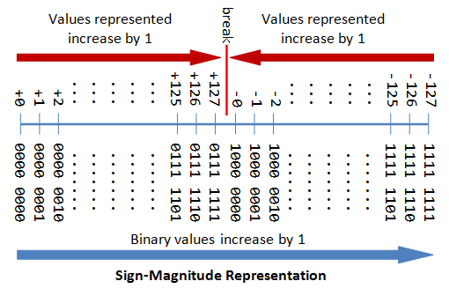
Signed Integers
2. Sign-Magnitude representation: The most-significant bit (MSB) is the sign bit, with value of 0 representing a positive integer and 1 representing a negative integer.
0 100 0001 | 1 000 0001
Sign bit 0 : positive | Sign bit 1: negative
+65 in integer | -1 in integer
Ref: https://www3.ntu.edu
The drawbacks of sign-magnitude representation are:
There are two representations (0000 0000B and 1000 0000B) for the number zero, which could lead to inefficiency and confusion.
Positive and negative integers need to be processed separately.

Slide 24
2. 1's Complement representation:
Again, the most significant bit (MSB) is the sign bit, with value of 0 representing positive integers and 1 representing negative integers.
The remaining n-1 bits represents the magnitude of the integer, as follows:
for positive integers, the absolute value of the integer is equal to "the magnitude of the (n-1)-bit binary pattern".
for negative integers, the absolute value of the integer is equal to "the magnitude of the complement (inverse) of the (n-1)-bit binary pattern" (hence called 1's complement).
0 100 0001B. | 1 000 0001B.
Sign bit is 0: positive | Sign bit is 1: negative
Abs value 65 And +65 in integer | Abs value is the complement of 000 0001B, i.e., 111 1110B = 126D And – 126 in integer

Slide 25
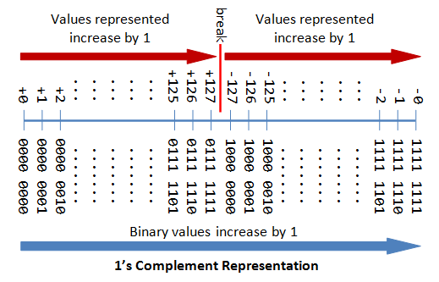
Ref: https://www3.ntu.edu
Again, the drawbacks are:
There are two representations (0000 0000B and 1111 1111B) for zero.
The positive integers and negative integers need to be processed separately.

Slide 26
3. 2's Complement representation
Again, the most significant bit (MSB) is the sign bit, with value of 0 representing positive integers and 1 representing negative integers.
The remaining n-1 bits represents the magnitude of the integer, as follows:
for positive integers, the absolute value of the integer is equal to "the magnitude of the (n-1)-bit binary pattern".
for negative integers, the absolute value of the integer is equal to "the magnitude of the complement of the (n-1)-bit binary pattern plus one" (hence called 2's complement).
0 100 0001 | 1 000 0001
Sign bit 0 : positive | Sign bit 1: negative
Abs value 65 | Abs value is 111 1110 + 1 = 127
+65 in integer | - 127 in integer

Slide 27
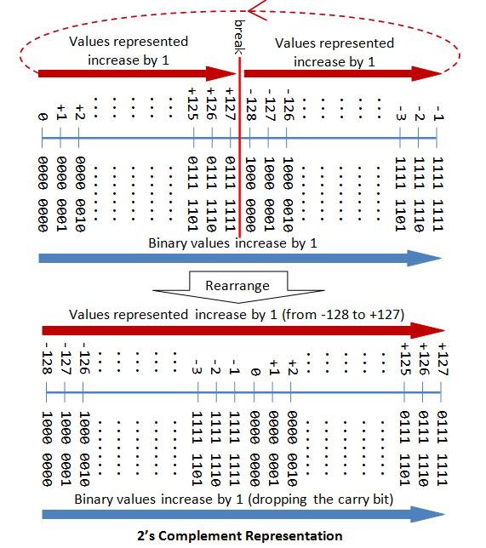
Ref: https://www3.ntu.edu

Slide 28
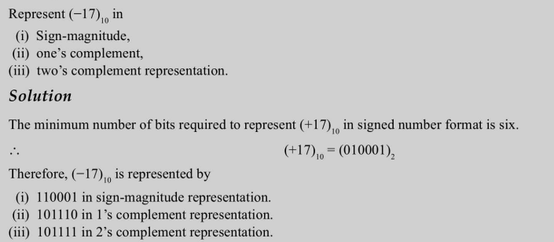
Solve :

Slide 29
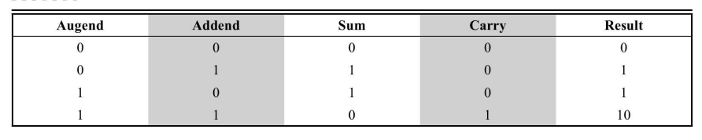

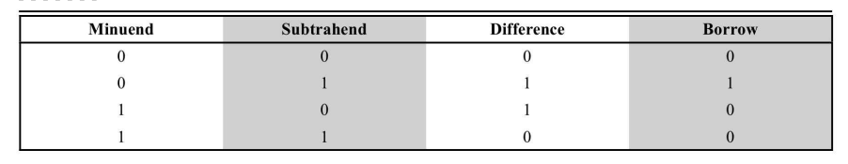
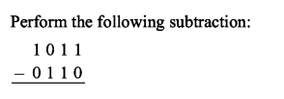
Binary Adder
Binary Subtractor:

Slide 30
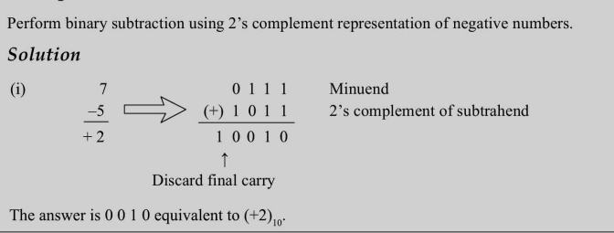
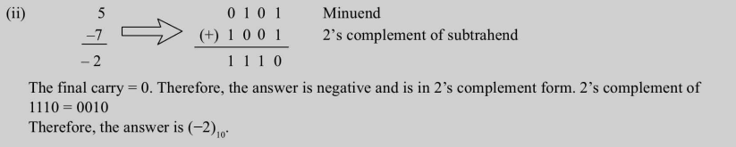

Slide 31
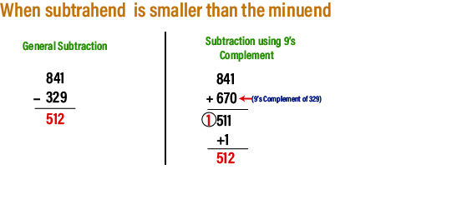
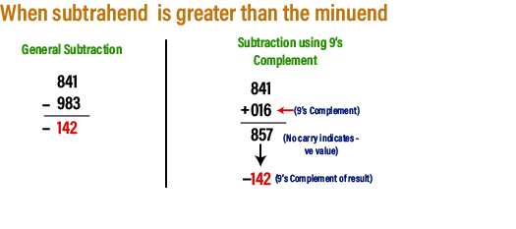
Subtraction using 9's complement

Slide 32
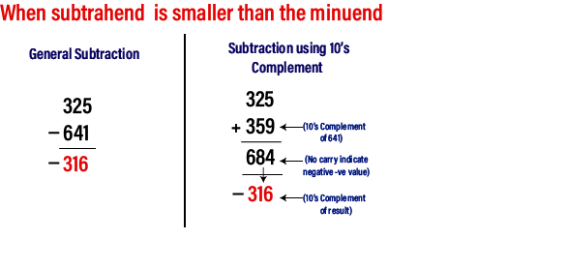
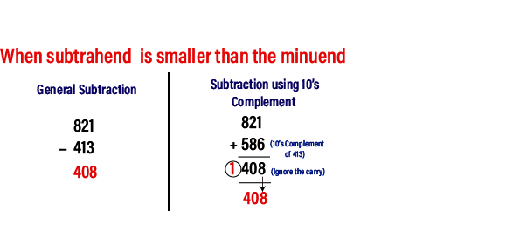
10's Complement

Slide 33

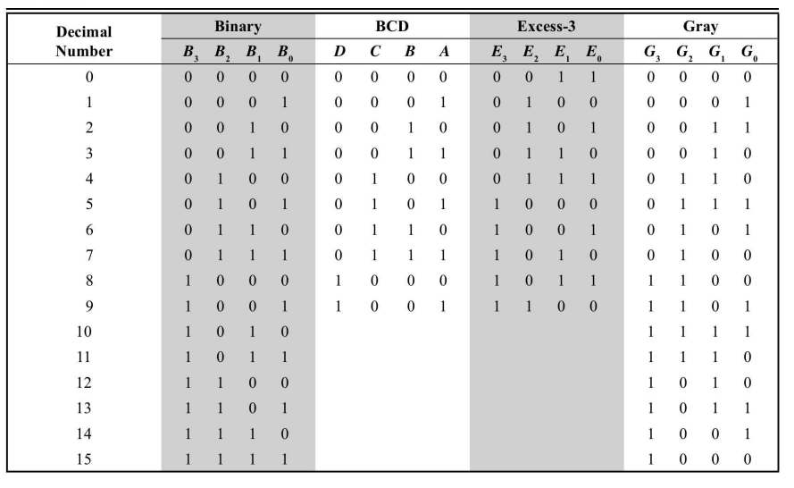

Slide 34
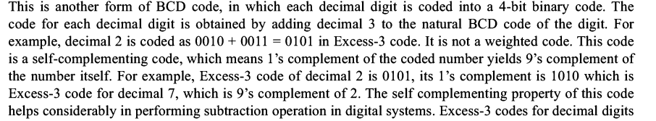
1. BCD : Binary Coded Decimal
0 to 9 are coded with 4 bit binary representation
This code is also known as 8-4-2-1 weighted Code.
e.g.
2. Excess- 3 Code
. This is another form of BCD Code
. Add decimal 3 to natural BCD code of digit
. 0010 + 0011= 0101 in excess- 3 Code

Slide 35

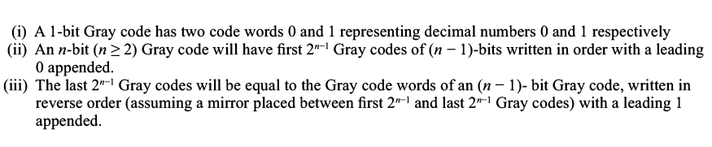
Each Gray Code differs from preceding and succeeding number by single bit.
It is not weighted code.
It is a reflected code.

Slide 36
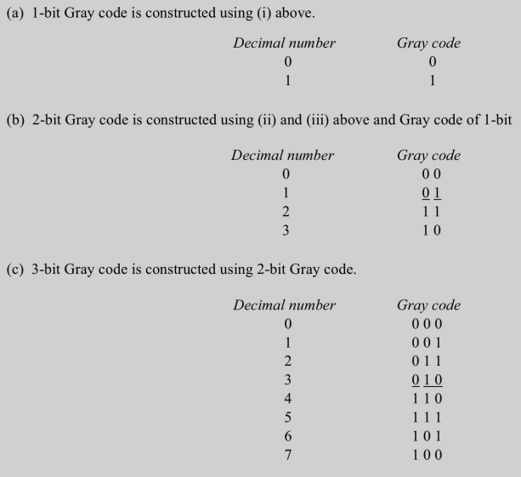

Slide 37
Exercise: Design a) 4 bit binary to gray code converter.
b) 4 bit gray to binary code converter.
Solution steps:
Steps:
truth table
Use k-maps to reduce min terms
Write Boolean expression using SOP form
Draw circuit diagram using gates

